Slide 1

GUI with Tkinter & Database Connectivity

Slide 2

Manishkumar R Solanki
Sr. Lecturer, Information Technology,
manish_ratilal2002@yahoo.com
SBMP

Slide 3
Students will be able to:
Design GUI using Tkinter
Develop GUI based Applications

Slide 4
Working with Tkinter

Slide 5
Python GUI
Tkinter is the inbuilt python module that is used to create GUI applications.
It is one of the most commonly used modules for creating GUI applications in Python as it is simple and easy to work with.
It gives an object-oriented interface to the Tk GUI toolkit.
Python Libraries available for creating our own GUI applications are:
Kivy
Python Qt
wxPython

Slide 6
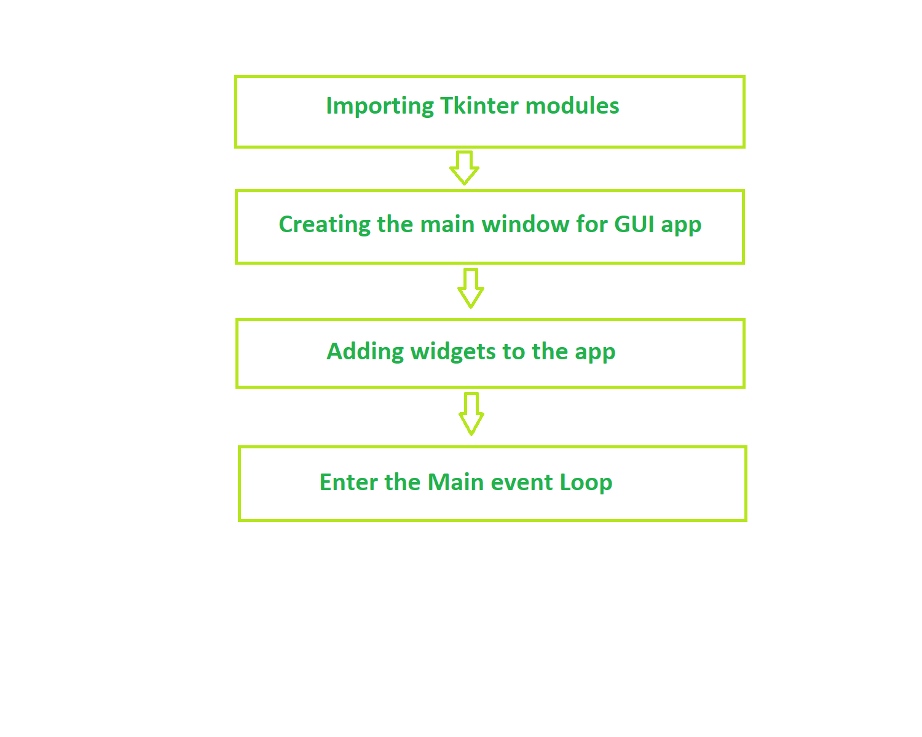
Python GUI Tkinter - Widgets
Widgets in Tkinter are the elements of GUI application which provides various controls (such as Labels, Buttons, ComboBoxes, CheckBoxes, MenuBars, RadioButtons and many more) to users to interact with the application.
Structure of Tkinter Application

Slide 7
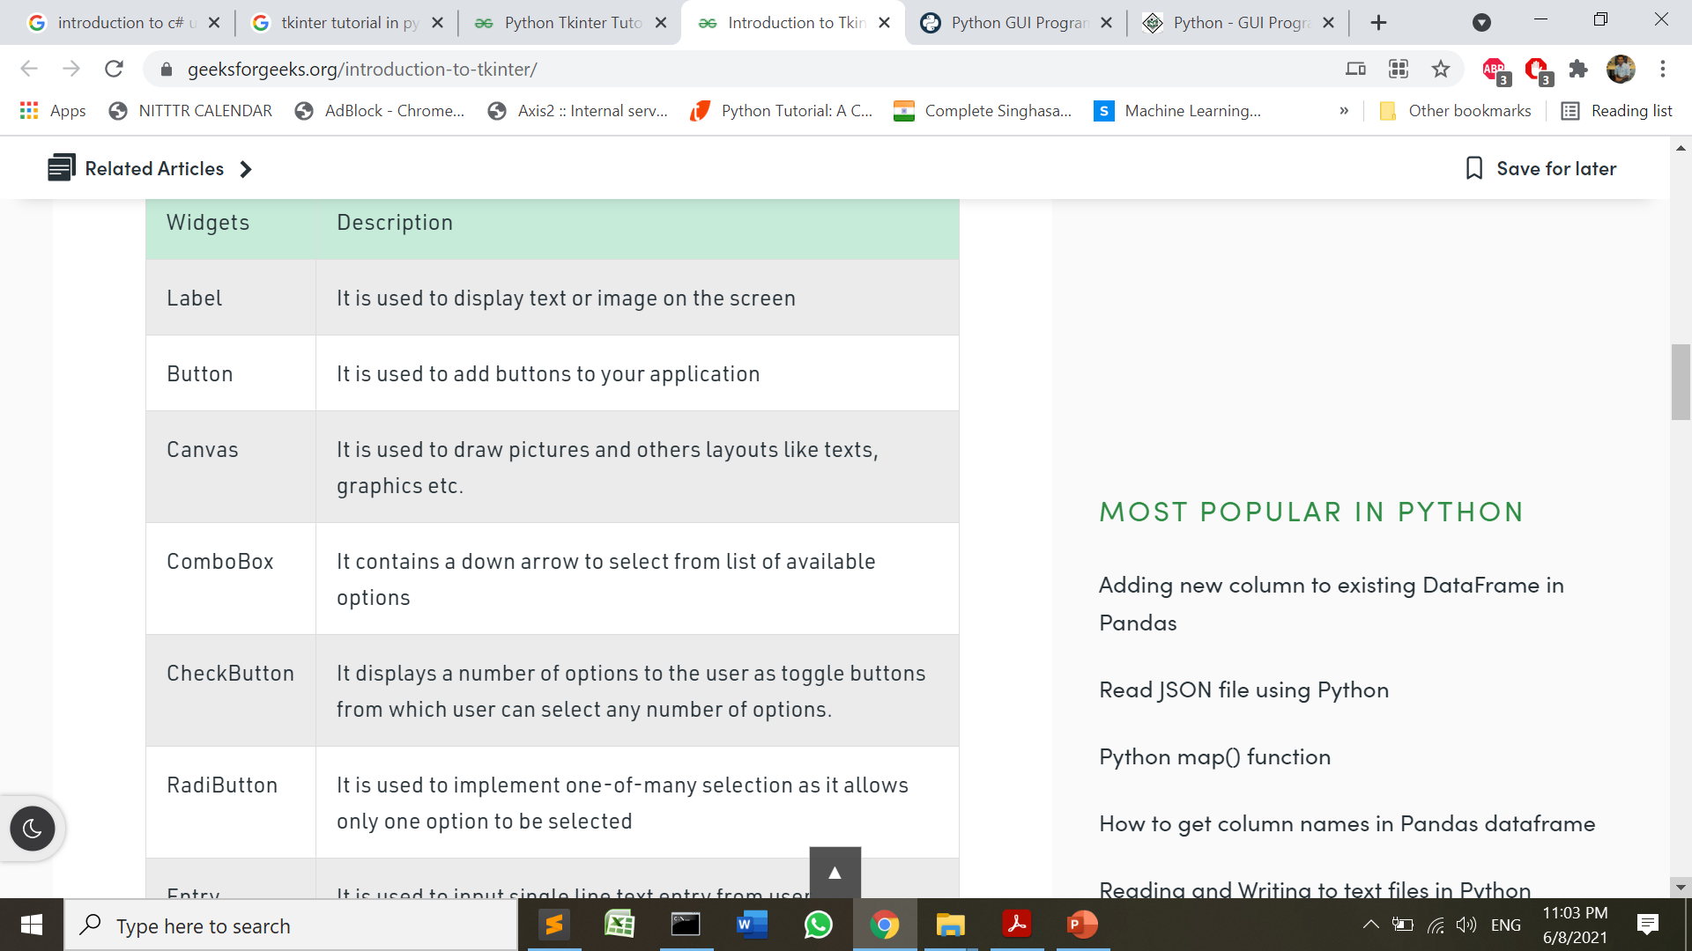
Tkinter Widgets

Slide 8
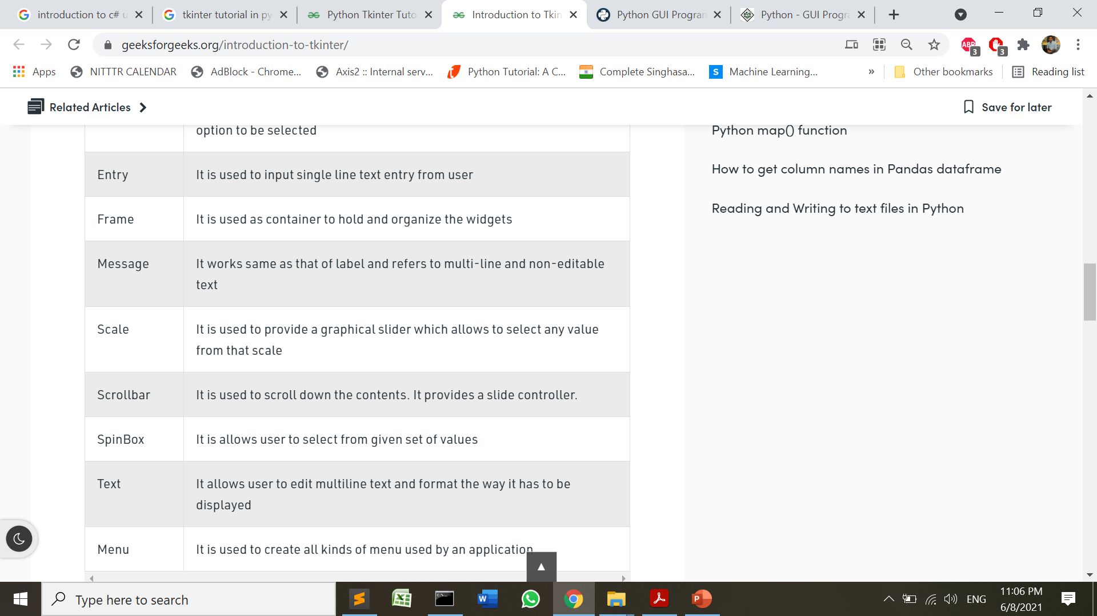
Tkinter Widgets

Slide 9
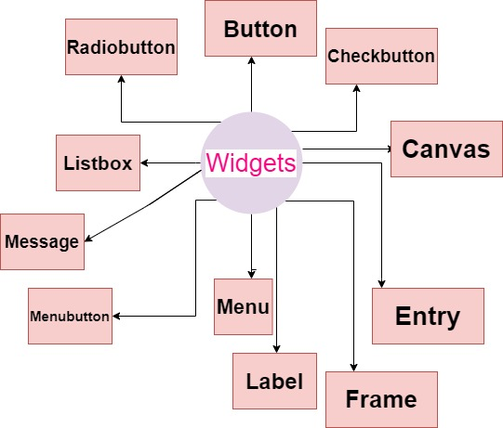
Tkinter Widgets

Slide 10
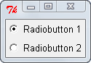
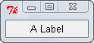
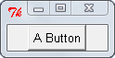
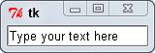
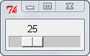
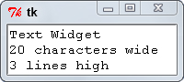
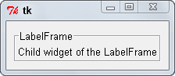
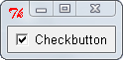
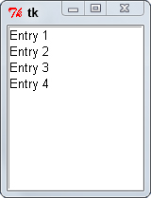
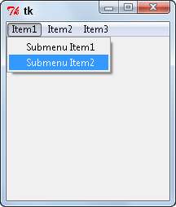
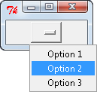
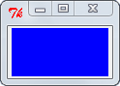
Tkinter Widgets

Slide 11
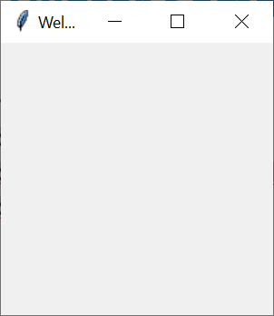
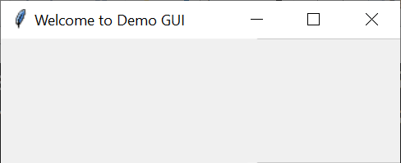
Tkinter Sample Program
from tkinter import *
window = Tk() # Get the main container object
window.title("Welcome to Demo GUI")
window.mainloop() #keeps displaying main window
The mainloop function, calls the endless loop of the window, so the window will wait for any user interaction till we close it.

Slide 12
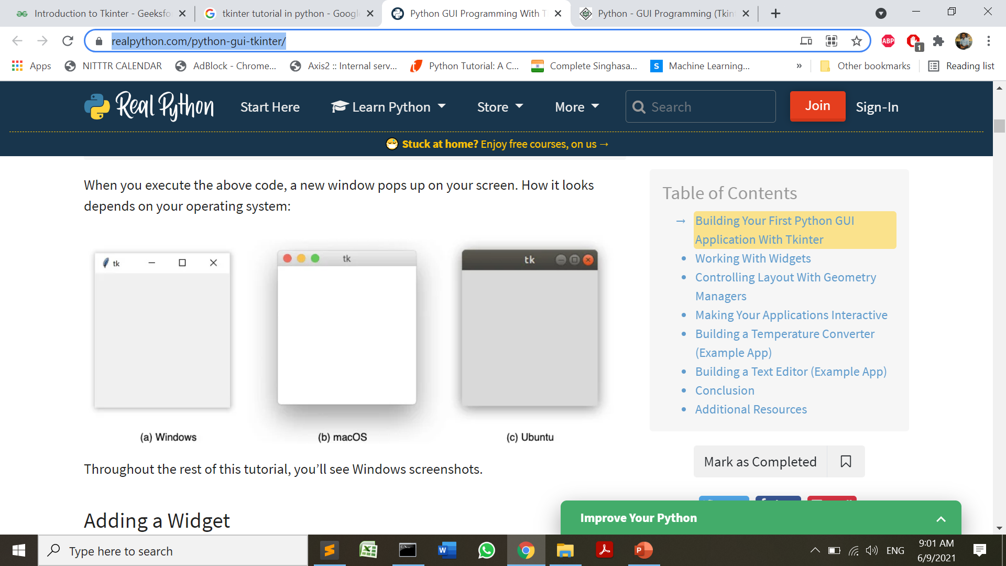
Tkinter Sample Program

Slide 13
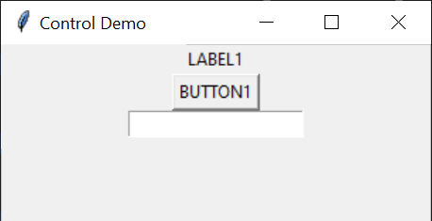
Basic GUI Controls
from tkinter import *
#from tkinter.ttk import *
window = Tk()
window.title("Label Demo")
label = Label(window, text ="LABEL1").pack()
bttn1 = Button(window, text = "BUTTON1")
bttn1.pack()
txt1 = Entry(window, text = "BUTTON1")
txt1.pack()
window.mainloop()

Slide 14
By default widgets are put in the center

Slide 15
Placing controls on GUI
.pack() uses a packing algorithm to place widgets in a Frame or window in a specified order. For a given widget, the packing algorithm has two primary steps:
Compute a rectangular area called a parcel that’s just tall (or wide) enough to hold the widget and fills the remaining width (or height) in the window with blank space.
Center the widget in the parcel unless a different location is specified.

Slide 16
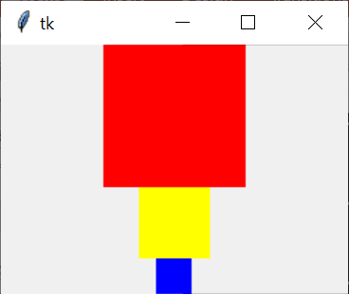
Placing controls on GUI
import tkinter as tk
window = tk.Tk()
frame1 = tk.Frame(master=window, width=100, height=100, bg="red")
frame1.pack()
frame2 = tk.Frame(master=window, width=50, height=50, bg="yellow")
frame2.pack()
frame3 = tk.Frame(master=window, width=25, height=25, bg="blue")
frame3.pack()
window.mainloop()

Slide 17
Placing controls on GUI
The Pack geometry manager packs widgets in rows or columns.
We can use options like fill, expand, and side to control this geometry manager.
expand − When set to true, widget expands to fill any space in widget's parent.
fill − Determines whether widget fills any extra space allocated to it by the packer, or keeps its own minimal dimensions: NONE (default), X (fill only horizontally), Y (fill only vertically), or BOTH (fill both horizontally and vertically).
side − Determines which side of the parent, widget packs against: TOP (default), BOTTOM, LEFT, or RIGHT.

Slide 18
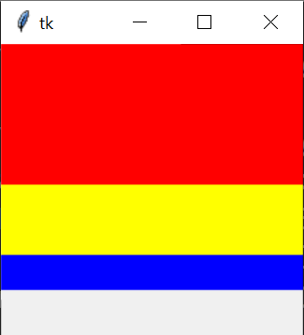
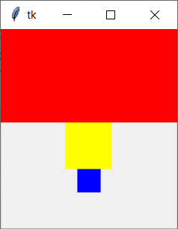
Placing controls on GUI
import tkinter as tk
#from tkinter import *
window = tk.Tk()
frame1 = tk.Frame(master=window, width=100, height=100, bg="red")
frame1.pack(fill=tk.X)
frame2 = tk.Frame(master=window, width=50, height=50, bg="yellow")
frame2.pack(fill=tk.X)
frame3 = tk.Frame(master=window, width=25, height=25, bg="blue")
frame3.pack(fill=tk.X)
window.mainloop()
Fig.a
Note: If we don’t specify any argument in pack() method of frame2 and frame3, we get output as shown in Figure b.
Fig.b

Slide 19
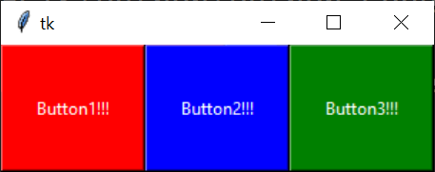
Placing controls on GUI
from tkinter import *
# from tkinter.ttk import *
w = Tk()
# cretaing a Frame which can expand according
# to the size of the window
f = Frame(w)
f.pack(fill = BOTH, expand = True)
# button widgets which can also expand and fill
# in the parent widget entirely
b1 = Button(f, text = "Button1!!!",
background = "red", fg = "white")
b1.pack(side = LEFT, expand = True, fill = BOTH)
b2 = Button(f, text = "Button2!!!",
background = "blue", fg = "white")
b2.pack(side = LEFT, expand = True, fill = BOTH)
b3 = Button(f, text = "Button3!!!",
background = "green", fg = "white")
b3.pack(side = LEFT, expand = True, fill = BOTH)
w.mainloop()

Slide 20
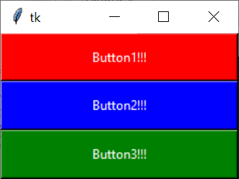
Placing controls on GUI
from tkinter import *
# from tkinter.ttk import *
w = Tk()
# cretaing a Frame which can expand according
# to the size of the window
f = Frame(w)
f.pack(fill = BOTH, expand = True)
# button widgets which can also expand and fill
# in the parent widget entirely
b1 = Button(f, text = "Button1!!!",
background = "red", fg = "white")
b1.pack(side = TOP, expand = True, fill = BOTH)
b2 = Button(f, text = "Button2!!!",
background = "blue", fg = "white")
b2.pack(side = TOP, expand = True, fill = BOTH)
b3 = Button(f, text = "Button3!!!",
background = "green", fg = "white")
b3.pack(side = TOP, expand = True, fill = BOTH)
w.mainloop()

Slide 21
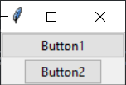
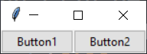
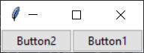
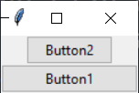
Side for buttons =TOP or default
Side for buttons =LEFT
Side for buttons =RIGHT
Side for buttons =BOTTOM

Slide 22
Placing controls on GUI
The .place() Geometry Manager:
.place() is used to control the precise location that a widget should occupy in a window or Frame.
We must provide two keyword arguments, x and y, which specify the x- and y-coordinates for the top-left corner of the widget. Both x and y are measured in pixels.

Slide 23
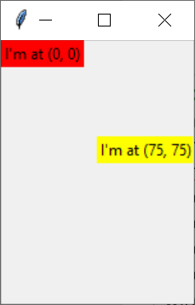
Placing controls on GUI
import tkinter as tk
window = tk.Tk()
frame = tk.Frame(master=window, width=150, height=150)
frame.pack()
label1 = tk.Label(master=frame, text="I'm at (0, 0)", bg="red")
label1.place(x=0, y=0)
label2 = tk.Label(master=frame, text="I'm at (75, 75)", bg="yellow")
label2.place(x=75, y=75)
window.mainloop()

Slide 24
Placing controls on GUI
The .grid() Geometry Manager:
.grid() works by splitting a window or Frame into rows and columns.
We have to specify the location of a widget by calling .grid() and passing the row and column indices to the row and column keyword arguments, respectively.
Both row and column indices start at 0, so a row index of 1 and a column index of 2 tells .grid() to place a widget in the third column of the second row.

Slide 25
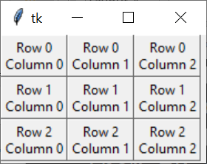
Placing controls on GUI
#import tkinter as tk
from tkinter import *
window = Tk()
for i in range(3):
for j in range(3):
frame = Frame(
master=window,
relief=RAISED,
borderwidth=1
)
frame.grid(row=i, column=j)
label = Label(master=frame, text=f"Row {i}\nColumn {j}")
label.pack()
window.mainloop()

Slide 26
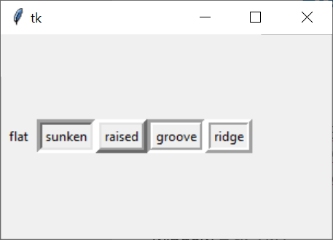
Placing controls on GUI
import tkinter as tk
border_effects = {
"flat": tk.FLAT,
"sunken": tk.SUNKEN,
"raised": tk.RAISED,
"groove": tk.GROOVE,
"ridge": tk.RIDGE,
}
window = tk.Tk()
for relief_name, relief in border_effects.items():
frame = tk.Frame(master=window, relief=relief, borderwidth=5)
frame.pack(side=tk.LEFT)
label = tk.Label(master=frame, text=relief_name)
label.pack()
window.mainloop()

Slide 27
Handling Events
An event is any action that occurs during the event loop that might trigger some behavior in the application, such as when a key or mouse button is pressed.
When an event occurs, an event object is emitted, which means that an instance of a class representing the event is instantiated.
Tkinter will create instances of event classes for you automatically.

Slide 28
Handling Events
We have to write the code that will be executed in response to an event. In Tkinter, We write functions called event handlers for the events that you use in your application.
i.e. for keypressed => handle_keypress(event)
But We have to register the event handler using bind() method.
.bind() method
To call an event handler whenever an event occurs on a widget, use .bind().
The event handler is said to be bound to the event because it’s called every time the event occurs.

Slide 29
Handling Events
.bind() always takes at least two arguments:
An event that’s represented by a string of the form "<event_name>", where event_name can be any of Tkinter’s events
An event handler that’s the name of the function to be called whenever the event occurs.
Syntax: container.bind(“<event_name>”, event_handler);

Slide 30
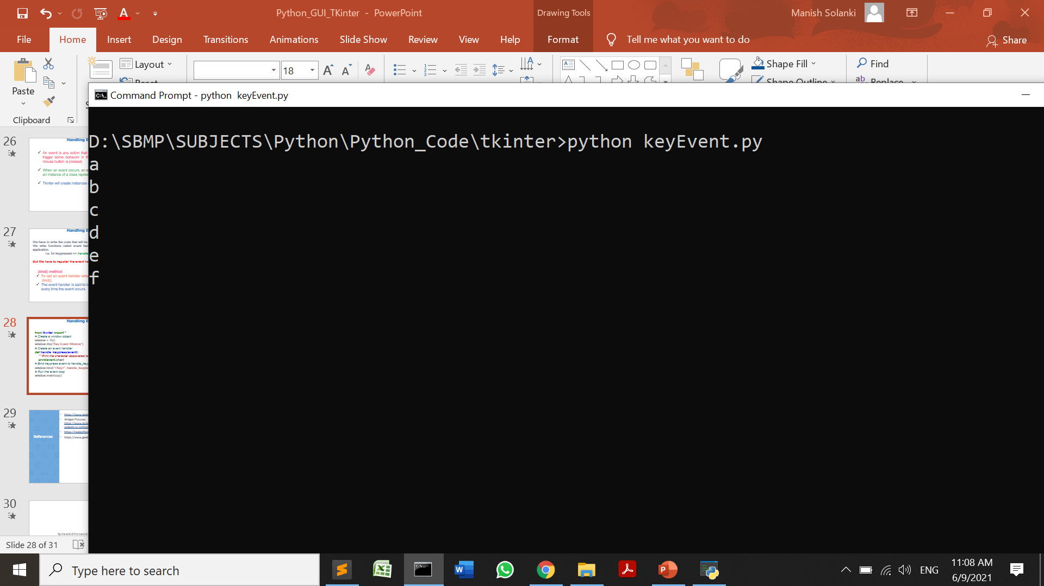
Handling Events
from tkinter import *
# Create a window object
window = Tk()
window.title("Key Event Window")
# Create an event handler
def handle_keypress(event):
"""Print the character associated to the key pressed"""
print(event.char)
# Bind keypress event to handle_keypress()
window.bind("<Key>", handle_keypress)
# Run the event loop
window.mainloop()

Slide 31
Handling Events
from tkinter import *
# Create a window object
window = Tk()
window.title("Key Event Window")
# Create an event handler
def handle_keypress(event):
"""Print the character associated to the key pressed"""
print(event.char)
# Bind keypress event to handle_keypress()
window.bind("<Key>", handle_keypress)
#Handling button click event
def handle_click(event):
print("The button was clicked!")
button = Button(window,text="Click me!").pack()
window.bind("<Button-1>", handle_click)
# Run the event loop
window.mainloop()

Slide 32
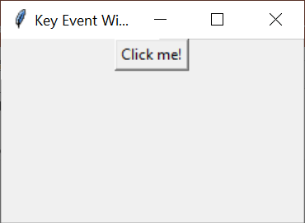
Handling Events
Note: In this script, we have used bind() method with window object so whenever we click on window area button click event will be generated. Same thing happens for key event
D:\SBMP\SUBJECTS\Python\Python_Code\tkinter>python keyEvent.py
The button was clicked!
s
The button was clicked!
d
The button was clicked!

Slide 33
Note: The button click event should be generated only when click on the button then we should invoke bind() with button object.
button.bind("<Button-1>", handle_click)

Slide 34
Events in Tkinter
<Button> | The left mouse button is defined by the event <Button-1>, the middle button by <Button-2>, and the rightmost mouse button by <Button-3>. <Button-4> defines the scroll up event on mice with wheel support and <Button-5> the scroll down.
<Motion> | The mouse is moved with a mouse button being held down. To specify the left, middle or right mouse button use <B1-Motion>, <B2-Motion> and <B3-Motion> respectively. The current position of the mouse pointer is provided in the x and y members of the event object passed to the callback, i.e. event.x, event.y
<ButtonRelease> | Event, if a button is released. To specify the left, middle or right mouse button use <ButtonRelease-1>, <ButtonRelease-2>, and <ButtonRelease-3> respectively
<Double-Button> | The button is double clicked instead of a single click. To specify the left, middle or right mouse button use <Double-Button-1>, <Double-Button-2>, and <Double-Button-3> respectively.

Slide 35
Events in Tkinter
<Enter> | The mouse pointer entered the widget.
<Leave> | The mouse pointer left the widget.
<FocusIn> | Keyboard focus was moved to this widget, or to a child of this widget.
<FocusOut> | Keyboard focus was moved from this widget to another widget.
<Key> | The user pressed any key. The key is provided in the char member of the event object passed to the callback (this is an empty string for special keys).
<Return> | <Return> The user pressed the Enter key. You can bind to virtually all keys on the keyboard: The special keys are Cancel (the Break key), BackSpace, Tab, Return(the Enter key), Shift_L (any Shift key), Control_L (any Control key), Alt_L (any Alt key), Pause, Caps_Lock, Escape, Prior (Page Up), Next (Page Down), End, Home, Left, Up, Right, Down, Print, Insert, Delete, F1, F2, F3, F4, F5, F6, F7, F8, F9, F10, F11, F12, Num_Lock, and Scroll_Lock.
<Shift-Up> | The user pressed the Up arrow, while holding the Shift key pressed. You can use prefixes like Alt, Shift, and Control
<Configure> | The size of the widget changed. The new size is provided in the width and height attributes of the event object passed to the callback. On some platforms, it can mean that the location changed.

Slide 36
Tkinter Events
Every App Requires the following points to be followed:
Use widgets to create the components of the user interface.
Use geometry managers to control the layout of the application.
Write functions that interact with various components to capture and transform user input.

Slide 37
Setting and Getting Data to and from Widgets
from tkinter import *
from tkinter.ttk import *
window = Tk()
window.geometry("400x300")
window.title("Label Demo")
label = Label(window, text ="LABEL1")
bttn1 = Button(window, text = "BUTTON1")
bttn1.pack()
txt1 = Entry(window, text = "ENTRY1")
#Setting Default Text of Entry Widget
txt1.insert(0, "This is the default text")
# OR
"""
text = StringVar()
text.set("This is the default text")
textBox = Entry(window,textvariable = text)
textBox.pack()
"""
To delete the content of entry widget => delete(0,”end”)

Slide 38
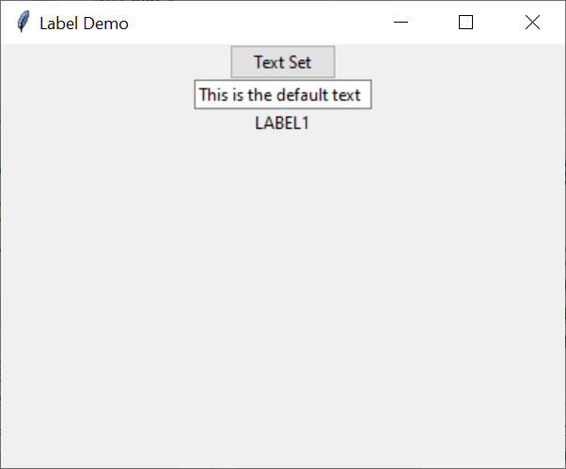
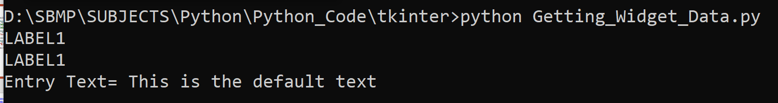
Setting and Getting Data to and from Widgets
txt1.pack()
#Getting label text
print(label.cget("text"))
print(label["text"])
# Setting Button text
bttn1["text"]="Text Set"
label.pack(); #pack() method is to be invoked at the last
#Getting entry text
print("Entry Text=",txt1.get())
window.mainloop()

Slide 39
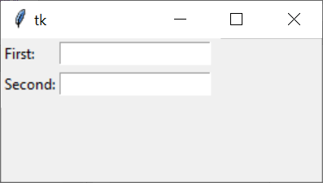
Putting widgets using grid manager
from tkinter import *
master = Tk()
# this wil create a label widget
l1 = Label(master, text = "First:")
l2 = Label(master, text = "Second:")
# grid method to arrange labels in respective
# rows and columns as specified
l1.grid(row = 0, column = 0, sticky = W, pady = 2)
l2.grid(row = 1, column = 0, sticky = W, pady = 2)
# entry widgets, used to take entry from user
e1 = Entry(master)
e2 = Entry(master)
# this will arrange entry widgets
e1.grid(row = 0, column = 1, pady = 2)
e2.grid(row = 1, column = 1, pady = 2)
mainloop()

Slide 40
Putting widgets using grid manager
column − The column to put widget in; default 0 (leftmost column).
columnspan − How many columns widgetoccupies; default 1.
ipadx, ipady − How many pixels to pad widget, horizontally and vertically, inside widget's borders.
padx, pady − How many pixels to pad widget, horizontally and vertically, outside v's borders.
row − The row to put widget in; default the first row that is still empty.
rowspan − How many rowswidget occupies; default 1.
sticky − What to do if the cell is larger than widget. By default, with sticky='', widget is centered in its cell. sticky may be the string concatenation of zero or more of N, E, S, W, NE, NW, SE, and SW, compass directions indicating the sides and corners of the cell to which widget sticks.

Slide 41
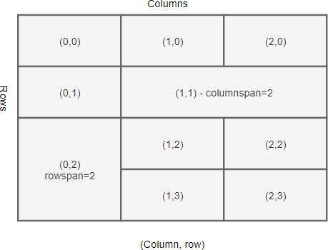

Slide 42
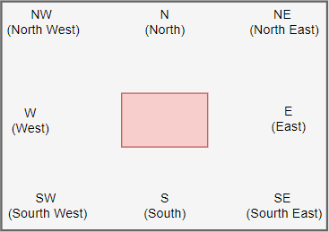
https://www.pythontutorial.net/tkinter/tkinter-grid/

Slide 43
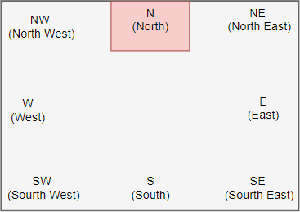
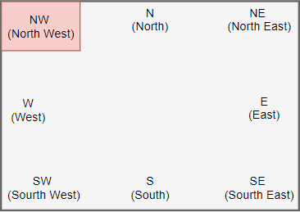
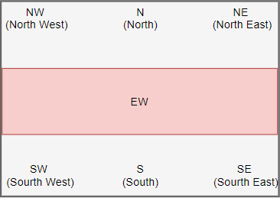
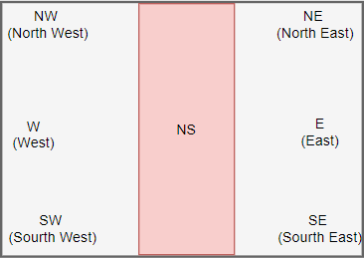

Slide 44
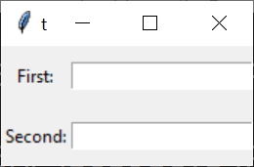
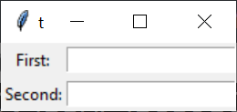
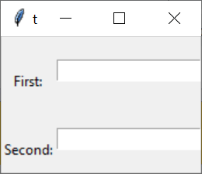
Putting widgets using grid manager
Label Pady=10
Label & entry Pady=2
Label pady=10 & entry Pady=20

Slide 45
Temperature Converter App
from tkinter import *
def fahrenheit_to_celsius():
"""Convert the value for Fahrenheit to Celsius and insert the
result into lbl_result.
"""
fahrenheit = txt_temp.get()
celsius = (5/9) * (float(fahrenheit) - 32)
lbl_result["text"] = f"{round(celsius, 2)} \N{DEGREE CELSIUS}"
window = Tk()
window.title("Temperature Converter")
frm_entry = Frame(master=window)
txt_temp = Entry(master=frm_entry, width=10)
lbl_temp = Label(master=frm_entry, text="\N{DEGREE FAHRENHEIT}")
txt_temp.grid(row=0, column=0, sticky="e")
lbl_temp.grid(row=0, column=1, sticky="w")

Slide 46
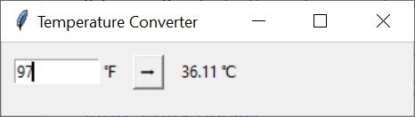
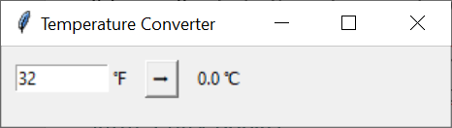
Temperature Converter App
btn_convert = Button(
master=window,
text="\N{RIGHTWARDS BLACK ARROW}",
command=fahrenheit_to_celsius
)
lbl_result = Label(master=window, text="\N{DEGREE CELSIUS}")
frm_entry.grid(row=0, column=0, padx=10)
btn_convert.grid(row=0, column=1, pady=10)
lbl_result.grid(row=0, column=2, padx=10)
#frm_entry.pack()
window.mainloop()

Slide 47
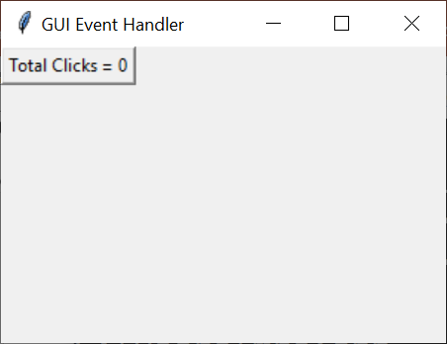
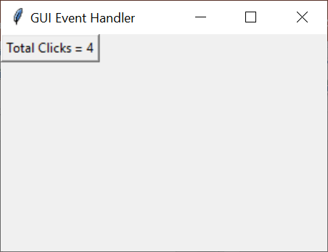
Tkinter Events
from tkinter import *;
class MyApp(Frame):
def __init__(self, master):
Frame.__init__(self, master);
self.grid();
# below is the number of button clicks
self.button_clicks = 0;
self.create_widget();
def create_widget(self):
self.buttn = Button(self, text = "Total Clicks = 0");
self.buttn["command"] = self.update_click_count;
self.buttn.grid();
def update_click_count(self):
self.button_clicks += 1;
self.buttn["text"] = "Total Clicks = " + str(self.button_clicks);
mainWindow = Tk();
mainWindow.title("GUI Event Handler");
mainWindow.geometry("300x200");
app = MyApp(mainWindow);
mainWindow.mainloop();

Slide 48
import tkinter as tk
from tkinter import ttk
class App(tk.Tk):
def __init__(self):
super().__init__()
self.geometry("240x100")
self.title('Login')
self.resizable(0, 0) # not resizable
# configure the grid column 1 is 3times wide of col 1
self.columnconfigure(0, weight=1)
self.columnconfigure(1, weight=3)
self.create_widgets()

Slide 49
def create_widgets(self):
# username
username_label = ttk.Label(self, text="Username:")
username_label.grid(column=0, row=0, sticky=tk.W, padx=5, pady=5)
username_entry = ttk.Entry(self)
username_entry.grid(column=1, row=0, sticky=tk.E, padx=5, pady=5)
# password
password_label = ttk.Label(self, text="Password:")
password_label.grid(column=0, row=1, sticky=tk.W, padx=5, pady=5)
password_entry = ttk.Entry(self, show="*")
password_entry.grid(column=1, row=1, sticky=tk.E, padx=5, pady=5)
# login button
login_button = ttk.Button(self, text="Login")
login_button.grid(column=1, row=3, sticky=tk.E,pady=10)

Slide 50

if __name__ == "__main__":
app = App()
app.mainloop()

Slide 51
Database Connectivity with MySQL

Slide 52

Installing MySQL Diver

Slide 53

Testing MySQL Connection
You need to know the following detail of the MySQL server to perform the connection from Python.

Slide 54
Testing MySQL Connection
import mysql.connector
mydb = mysql.connector.connect(
host="localhost",
user="root",
password=""
)
if mydb:
print("Connection Established Successfully")
else:
print("Connection Error")
Connection Established Successfully

Slide 55

Testing MySQL Connection
Steps to connect a python application to the database.
Import mysql.connector module
Create the connection object.
Create the cursor object
Execute the query

Slide 56
Testing MySQL Connection
Import mysql.connector module : Module responsible for providing MySQL database connectivity with Python.
2. Create the connection object:
To create a connection between the MySQL database and the python application, the connect() method of mysql.connector module is used.
We have to pass database details like HostName, username, and the database password in the method call. The method returns the connection object.

Slide 57
Testing MySQL Connection
3. Create the cursor object: Use the cursor() method of a MySQLConnection object to create a cursor object to perform various SQL operations.
4. Execute the query: To execute a database query we have to use cursor.execute() function. Then we can invoke cursor.fetchall() or fetchone() or fetchmany() to read query result.

Slide 58
Creating a Database
import mysql.connector
try:
con = mysql.connector.connect(
host="localhost",
user="root",
password="",
)
print("Connection Established Successfully")
cur = con.cursor()
cur.execute("create database test2")
print("1")
cur.execute("show databases")
dbs=cur.fetchall()
for x in dbs:
print(x)
except:
print("Connection Error")
1
('college',)
('company',)
('flutter',)
('information_schema',)
('mysql',)
('performance_schema',)
('phpmyadmin',)
('productmaster',)
('test',)
('test1',)
('test2',)

Slide 59
We can specify the database name in the connect() method if we want to connect to a specific database.

Slide 60
Retrieving data from the table
import mysql.connector
try:
con = mysql.connector.connect(
host="localhost",
user="root",
password="",
database="college"
)
print("Connection Established Successfully")

Slide 61
Retrieving data from the table
#creating the cursor object
cur = con.cursor()
print(cur)
#id,name,sem,city
sql="select * from student"
cur.execute(sql)
result = cur.fetchall()
print("ID Name Sem City")
for row in result:
#print(row)
print("%d %s %d %s"%(row[0],row[1],row[2],row[3]))
except:
print("Connection Error")
finally:
if con:
con.close()
print("Resources Released")
Connection Established Successfully
MySQLCursor: (Nothing executed yet)
ID Name Sem City
1 Rakesh 2 Baroda
2 Mahesh 3 Pune
Resources Released

Slide 62
cursor.fetchall() fetches all the rows of a query result. It returns all the rows as a list of tuples. An empty list is returned if there is no record to fetch.
cursor.fetchmany(size) returns the number of rows specified by size argument. When called repeatedly, this method fetches the next set of rows of a query result and returns a list of tuples. If no more rows are available, it returns an empty list.
cursor.fetchone() method returns a single record or None if no more rows are available

Slide 63
In the real world, fetching all the rows at once may not be feasible. So Python DB API solves this problem by providing different versions of the fetch function of the Cursor class. The most commonly used version is the cursor.fetchmany(size), size= no. of rows/tuples to be fetched

Slide 64
Updating data in the table
import mysql.connector
try:
con = mysql.connector.connect(
host="localhost",
user="root",
password="",
database="college"
)
print("Connection Established Successfully")
#creating the cursor object
cur = con.cursor()
print(cur)
#id,name,sem,city
sql="update student set city='Baroda' where city='Mumbai'"
cur.execute(sql)
print(cur.rowcount,"Records updated")
except:
print("Connection Error")
finally:
if con:
con.close()
print("Resources Released")
Connection Established Successfully
MySQLCursor: (Nothing executed yet)
1 Records updated
Resources Released

Slide 65
Sample Queries
"SELECT * FROM customers WHERE address =‘Parsiwada,Andheri(E)'"
"DELETE FROM customers WHERE address = ’42,Carter Road,Bandra(W)'"
"DROP TABLE customers"
"UPDATE customers SET address = ’23,Beach Heaven,Juhu Koliwada' WHERE address = ’45,Sea Queen,SNDT'"

Slide 66
Login Form
from tkinter import *
import mysql.connector
def submitact():
user = Username.get()
passw = password.get()
#print(f"The name entered by you is {user} {passw}")
logintodb(user, passw)
def logintodb(user, passw):
con = mysql.connector.connect(
host="localhost",
user="root",
password="",
database="college"
)

Slide 67
Login Form
cursor = con.cursor()
# A Table in the database
savequery = "select * from login"
try:
cursor.execute(savequery)
myresult = cursor.fetchall()
status=False
# Printing the result of the
# query
for x in myresult:
if x[0]==user and x[1]==passw :
status=True
break;
if status:
print("Login Sccessful")
else:
print("Login Failed")
except:
db.rollback()
print("Error occured")

Slide 68
Login Form
# Creating GUI
root = Tk()
root.geometry("300x300")
root.title("Login Page")
# Definging the first row
lblfrstrow = Label(root, text ="Username -", )
lblfrstrow.place(x = 50, y = 20)
Username = Entry(root, width = 35)
Username.place(x = 150, y = 20, width = 100)
lblsecrow = Label(root, text ="Password -")
lblsecrow.place(x = 50, y = 50)
password = Entry(root, show="*",width = 35)
password.place(x = 150, y = 50, width = 100)
submitbtn = Button(root, text ="Login",
bg ='blue', command = submitact)
submitbtn.place(x = 150, y = 135, width = 55)
root.mainloop()

Slide 69


Login Form
Login Failed
Login Sccessful

Slide 70


Slide 71


Slide 72


Slide 73
from tkinter.ttk import *
from tkinter import *
import mysql.connector
from tkinter import messagebox
mydb = mysql.connector.connect(
host="localhost",
user="root",
password="",
database="college"
)
mycursor = mydb.cursor()

Slide 74
root = Tk()
root.title("Student Data")
root.geometry("500x200")
label1 = Label(root, text="RollNo", width=20, height=2,
bg="pink").grid(row=0, column=0)
label2 = Label(root, text="Name", width=20,
height=2, bg="pink").grid(row=1, column=0)
label3 = Label(root, text="Sem", width=20, height=2,
bg="pink").grid(row=2, column=0)
label4 = Label(root, text="City", width=20, height=2,
bg="pink").grid(row=3, column=0)
e1 = Entry(root, width=30, borderwidth=8)
e1.grid(row=0, column=1)
e2 = Entry(root, width=30, borderwidth=8)
e2.grid(row=1, column=1)
e3 = Entry(root, width=30, borderwidth=8)
e3.grid(row=2, column=1)
e4 = Entry(root, width=30, borderwidth=8)
e4.grid(row=3, column=1)

Slide 75
def Register():
Id = e1.get()
Insert = "Insert into student(id,name,sem,city) values(%s,%s,%s,%s)"
Name = e2.get()
Sem = e3.get()
City = e4.get()
if(Id!= "" and Name!="" and Sem!="" and City != ""):
Value = (Id,Name,Sem,City)
mycursor.execute(Insert, Value)
mydb.commit()
messagebox.askokcancel("Information", "Record inserted")
e1.delete(0, END)
e2.delete(0, END)
e3.delete(0, END)
e4.delete(0, END)

Slide 76
else:
if (Id == "" and Name == "" and Sem == "" and City == "" ):
messagebox.askokcancel(
"Information", "New Entery Fill All Details")
else:
messagebox.askokcancel("Information", "Some fields left blank")
def Clear():
e1.delete(0, END)
e2.delete(0, END)
e3.delete(0, END)
e4.delete(0, END)
button1 = Button(root, text="Register", width=10, height=2,
command=Register).grid(row=7, column=0)
button2 = Button(root, text="Clear", width=10, height=2,
command=Clear).grid(row=7, column=1)
root.mainloop()

Slide 77


Slide 78


Slide 79


Slide 80



Slide 81


Slide 82
cur.commit() is required to make the changes in the table.

Slide 83
References
https://www.w3schools.com/python/python_mysql_update.asp
https://www.javatpoint.com/python-mysql-read-operation
https://www.geeksforgeeks.org/create-mysql-database-login-page-in-python-using-tkinter/
https://www.krazyprogrammer.com/2020/11/insert-data-in-mysql-using-python.html
https://www.c-sharpcorner.com/article/creating-a-crudcreate-retrieveupdate-and-delete-desktop-application-using-pyt2/
Database Connectivity
https://pynative.com/python-mysql-database-connection/

Slide 84
THANKS!
Any questions?
You can find me at
manish_ratilal2002@yahoo.com

